Slide 1

SOFTWARE ENGINEERING
Software Implementation and Testing I

Slide 2
Agenda
Implementation/Programming Guidelines
Software Testing Concepts
Unit Testing
Module Integration and Testing Strategies
Testing Approaches
White-Box Testing
Black-Box Testing
Other Types of Testing

Slide 3

Implementation/Programming Guidelines
Implementation/Programming Guidelines
Software Testing Concepts
Unit Testing
Module Integration and Testing Strategies
Testing Approaches
White-Box Testing
Black-Box Testing
Other Types of Testing

Slide 4
Good Programming Practice
Use of consistent and meaningful variable names
“Meaningful” to future maintenance programmers
“Consistent” to aid future maintenance programmers

Slide 5
Use of Consistent and Meaningful Variable Names
A code artifact includes the variable names freqAverage, frequencyMaximum, minFr, frqncyTotl
A maintenance programmer has to know if freq, frequency, fr, frqncy all refer to the same thing
If so, use the identical word, preferably frequency, perhaps freq or frqncy, but not fr
If not, use a different word (e.g., rate) for a different quantity

Slide 6
Consistent and Meaningful Variable Names
We can use frequencyAverage, frequencyMaximum, frequencyMinimum, frequencyTotal
We can also use averageFrequency, maximumFrequency, minimumFrequency, totalFrequency
But all four names must come from the same set

Slide 7
Tags in doc comments I
Establish and use a fixed ordering for javadoc tags.
In class and interface descriptions, use:
@author your name @version a version number or date
In method descriptions, use:
@param p A description of parameter p. @return A description of the value returned (unless it’s void). @exception e Describe any thrown exception.

Slide 8
Tags in doc comments II
Fully describe the signature of each method.
The signature is what distinguishes one method from another
the signature includes the number, order, and types of the parameters
Use a @param tag to describe each parameter
@param tags should be in the correct order
Don’t mention the parameter type; javadoc does that
Use a @return tag to describe the result (unless it’s void)

Slide 9
Use of Parameters
There are almost no genuine constants
One solution:
Use const statements (C++), or
Use public static final statements (Java)
A better solution:
Read the values of “constants” from a parameter file

Slide 10
Input and output conditions
Document preconditions, postconditions, and invariant conditions.
A precondition is something that must be true beforehand in order to use your method
Example: The piece must be moveable
A postcondition is something that your method makes true
Example: The piece is not against an edge
An invariant is something that must always be true about an object
Example: The piece is in a valid row and column

Slide 11
Nested if Statements (contd)
A combination of if-if and if-else-if statements is usually difficult to read
Simplify: The if-if combination
if <condition1>
if <condition2>
is frequently equivalent to the single condition
if <condition1> && <condition2>
Rule of thumb
if statements nested to a depth of greater than three should be avoided as poor programming practice

Slide 12
Programming Standards
Standards can be both a blessing and a curse
Modules of coincidental cohesion arise from rules like
“Every module will consist of between 35 and 50 executable statements”
Better
“Programmers should consult their managers before constructing a module with fewer than 35 or more than 50 executable statements”

Slide 13
Examples of Good Programming Standards
“Nesting of if statements should not exceed a depth of 3, except with prior approval from the team leader”
“Modules should consist of between 35 and 50 statements, except with prior approval from the team leader”
“Use of goto should be avoided. However, with prior approval from the team leader, a forward goto may be used for error handling”
These programming standards reduce the complexity of the code and improve its readability and maintainability.

Slide 14
Cyclomatic Complexity
Cyclomatic Complexity V(G) is defined as the number of regions in the flow graph.
V(G) = E – N + 2
E: number of edges in flow graph
N: number of nodes in flow graph
Another method: V(G) = P + 1 P: number of predicate nodes (simple decisions) in flow graph
14

Slide 15
Flow chart
Example-1
Flow graph
1
Edge
1
2,3
2,3
2
6
3
7
8
R2
4,5
R3
4
R1
6
Region
9
7
8
5
R4
9
10
10
11
11
15

Slide 16
Flow Graph Notation
Each circle represents one or more nonbranching source code statements.
if-else
switch
Sequence
While
Until
16

Slide 17
Compound Logic
a
If a OR b
then procedure x
else procedure y
ENDIF
b
x
y
x
17

Slide 18
Example-1 (Cyclomatic Complexity)
V(G) = E – N + 2 = 11 – 9 + 2 = 4
Other method: V(G) = P + 1 = 3 + 1 = 4
18

Slide 19
Flow chart
Example-2
Flow graph
1
1
2
2
4
3
3
6
4
5
5
6
7
7
8
8
19

Slide 20
Example-2 (Cyclomatic Complexity)
First, we calculate V(G):
V(G) = E – N + 2 = 10 – 8 + 2 = 4
Now, we derive the independent paths :
Since V(G) = 4, there are four paths
Path 1 : 1,2,3,6,7,8
Path 2 : 1,2,3,5,7,8
Path 3 : 1,2,4,7,8
Path 4 : 1,2,4,7,2,4,...7,8
20

Slide 21
Software Testing Concepts
Implementation/Programming Guidelines
Software Testing Concepts
Unit Testing
Module Integration and Testing Strategies
Testing Approaches
White-Box Testing
Black-Box Testing
Other Types of Testing

Slide 22
Software Testing
Testing is the process of executing a program to find errors.
Testing is planned by defining “Test Cases” in a systematic way.
A test case is a collection of input data and expected output.
A good test case is one that has a high probability of finding an as-yet-undiscovered error.
A successful test is one that uncovers an as-yet-undiscovered error.
22

Slide 23
Principles
Most of the tests should be traceable to requirements.
Both customer and system requirements
Tests should be planned and implemented long before testing begins.
After requirements model is complete.
Except unit testing, because units should be implemented before the tests in a test-last approach.
Exhaustive testing is impossible.
Testing should be conducted by the developer of the software and also by an independent test group.

Slide 24
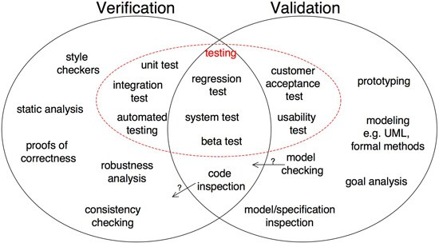
Verification and Validation
Verification: Are we building the product right?
Validation: Are we building the right product?
unit testing
Figure from S. Easterbrook 2010
24

Slide 25
Phases of Testing
1. Unit Testing
Does each module do what it supposed to do?
2. Integration Testing
Do you get the expected results when the parts are put together?
3. System Testing
Does it work within the overall system?
Does the program satisfy the requirements ?
25

Slide 26
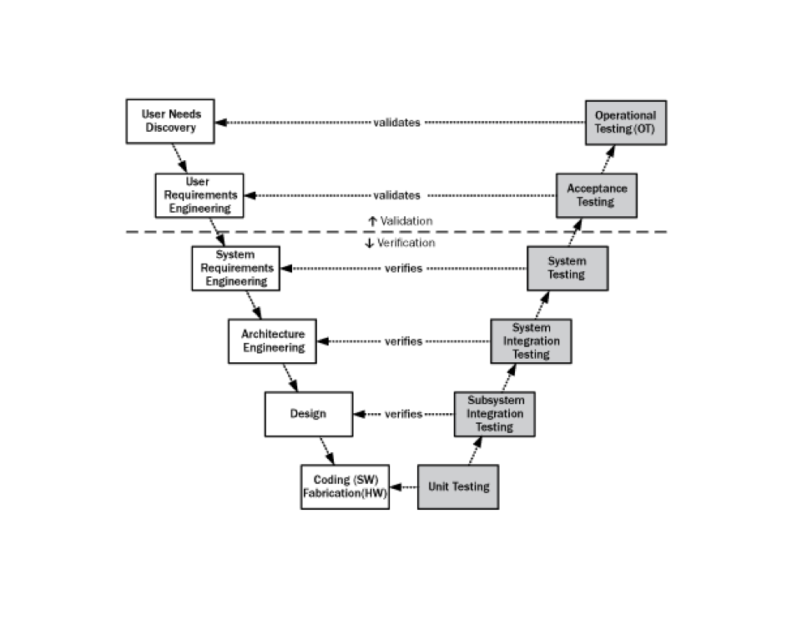
Levels of Testing
Figure from sei.cmu.edu
26
Notes:
26

Slide 27
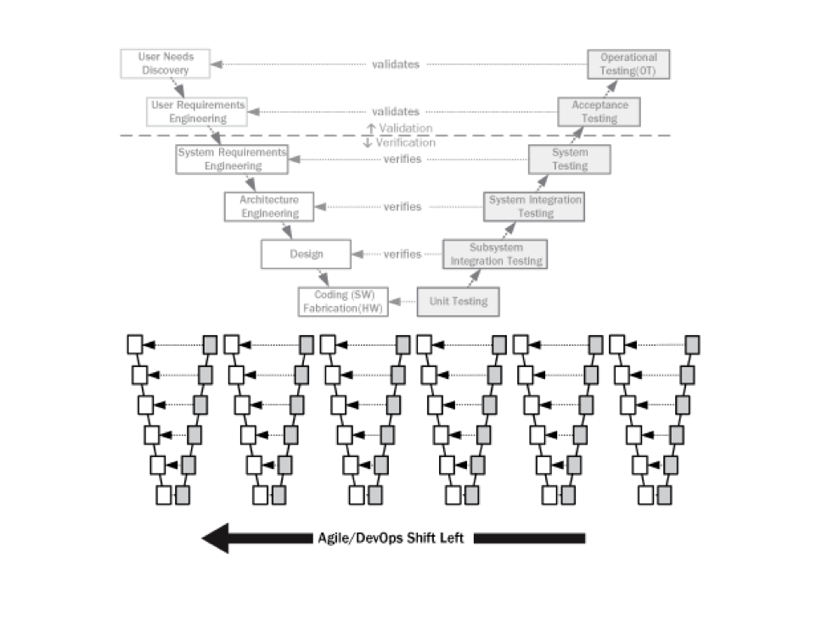
Levels of testing in Agile
Figure from sei.cmu.edu

Slide 28
Unit Testing
Implementation/Programming Guidelines
Software Testing Concepts
Unit Testing
Module Integration Testing
Testing Approaches
White-Box Testing
Black-Box Testing
Other Types of Testing

Slide 29
Unit Testing
Testing the smallest units of the code (methods, classes)
Dynamic execution:
Test the input/output behavior
Also test the internal logic
There are other static analysis techniques that are not considered as testing.
Hand execution/Code review (Reading the source code)
Code inspection (also known as Walkthrough)
Automated tools checking for syntactic and semantic errors (FindBugs)
29

Slide 30
Unit testing
Unit testing is done by programmers, for programmers.
Unit tests are performed to prove that a piece of code does what the developer thinks it should do.
When there are dependencies between the units, it is the programmers responsibility to reduce such dependencies as much as possible, or to use additional strategies for testing the module as a whole.

Slide 31
Test Environment
Stubs and drivers should be written in integration/unit testing.
Test
cases
Results
driver
Module
stub
stub
31

Slide 32
Stub modules and driver modules
A stub is an empty (dummy) module, which:
Just prints a message (“Module X called"), or
Returns pre-determined values from pre-planned test cases.
Used in top-down strategy
A driver is a caller module, which calls its stubs:
Once or several times,
Each time checking the value returned.
Used in bottom-up strategy
32

Slide 33
Example: Stubs and driver (1)
void main()
Driver
int f1()
bool f2()
bool f3()
Stubs
33

Slide 34
Example: Stubs and driver (2)
#include <stdio.h> #include <math.h> #define TRUE 1 #define FALSE 0 // f2 is a stub bool f2(int X) { return TRUE; } // f3 is a stub bool f3(int X) { return TRUE; }
// We are testing f1 int f1(int X) { if (f2(X) || f3(X)) printf("%f", sqrt(X)); else printf("Invalid value for X“); } // This is the driver. void main() { f1(49); }
34

Slide 35
Module Integration Testing and Strategies
Implementation/Programming Guidelines
Software Testing Concepts
Unit Testing
Module Integration Testing
Testing Approaches
White-Box Testing
Black-Box Testing
Other Types of Testing

Slide 36
A strategic approach to Testing
Testing begins at the module level and works outward toward the integration of the entire system.
Different testing techniques are appropriate at different points in time.
36

Slide 37
Strategies for Integration Testing
1) Big bang approach:
All modules are fully implemented and combined as a whole, then tested as a whole. It is not practical.
2) Incremental approach: (Top-down or Bottom-up)
Program is constructed and tested in small clusters.
Errors are easier to isolate and correct.
Interfaces between modules are more likely to be tested completely.
After each integration step, a regression test is conducted.
37

Slide 38
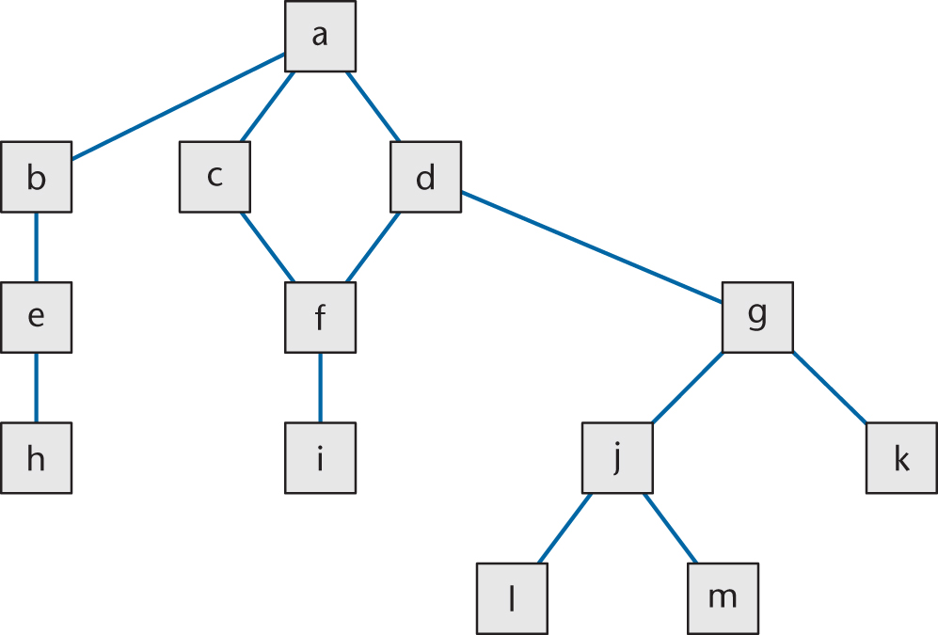
Big bang integration testing
Integration and testing at once:
1. a, b, c, …, l, m
38

Slide 39
Top-down Integration
If code artifact mAbove sends a message to artifact mBelow, then mAbove is implemented and integrated before mBelow
One possible top-down ordering is
a, b, c, d, e, f, g,
h, i, j, k, l ,m

Slide 40
Top-down Integration (contd)
Another possible top-down ordering is
a
[a] b, e, h
[a] c ,d, f, i
[a, d] g, j, k, l, m

Slide 41
Bottom-up Integration
If code artifact mAbove calls code artifact mBelow, then mBelow is implemented and integrated before mAbove
One possible bottom-up ordering is
l, m,
h, i, j, k,
e, f, g,
b, c, d,
a

Slide 42
Bottom-up Integration
Another possible bottom-up ordering is
h, e, b
i, f, c, d
l, m, j, k, g [d]
a [b, c, d]

Slide 43
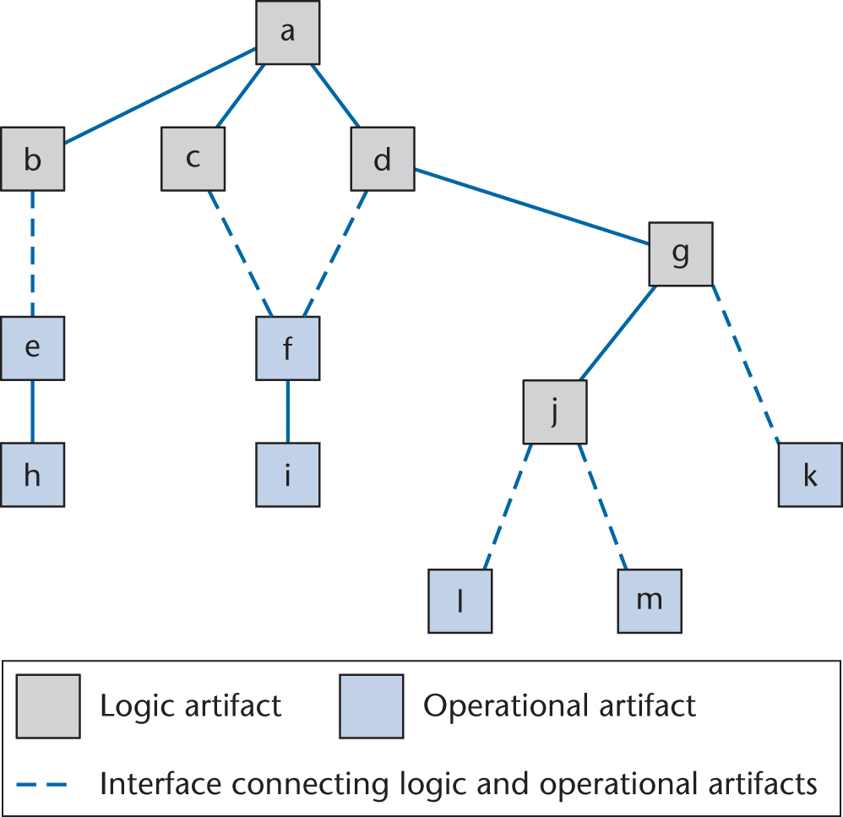
Sandwich Integration
Logic artifacts are integrated top-down
Operational artifacts are integrated bottom-up
Finally, the interfaces between the two groups are tested
Figure 15.7

Slide 44
Testing Approaches
Implementation/Programming Guidelines
Software Testing Concepts
Unit Testing
Module Integration and Testing Strategies
Testing Approaches
White-Box Testing
Black-Box Testing
Other Types of Testing

Slide 45
Testing Approaches
Black-box testing
Testing of the software interfaces
Used to demonstrate that
functions are operational
input is properly accepted and output is correctly produced
White-box testing
Close examination of procedural details
Logical paths through the software is tested by test cases that exercise specific sets of conditions and loops
45

Slide 46
Exhaustive Testing
There are 5 separate paths inside the following loop.
Assuming loop <= 20, there are 5²⁰ ≈ 10¹⁴ possible paths.
Exhaustive testing is not feasible.
loop
46

Slide 47
Selective Testing
Instead of exhausting testing, a selective testing is more feasible.
Selected path
loop
47

Slide 48
Testing to Specifications versus Testing to Code
There are two extremes to testing
Test to code (also called glass-box, logic-driven, structured, or path-oriented testing)
Ignore the specifications — use the code to select test cases
Test to specifications (also called black-box, data-driven, functional, or input/output driven testing)
Ignore the code — use the specifications to select test cases

Slide 49
Example: Script for Unit Testing
This is the format for a test plan to show what you’re planning to do.
It should to be filled to show what happened when you run tests.
Scenario # : 1 Tester: AAA BBB Date of Test: 01/01/2010
Test Number | Test Description / Input | Expected Result | Actual Result | Fix Action
1 | Invalid file name | “Error: File does not exist”
2 | Valid filename, but file is binary | “Error: File is not a text file”
3 | Valid filename | “Average = 99.00”
4
5
49

Slide 50
White-Box Testing
Implementation/Programming Guidelines
Software Testing Concepts
Unit Testing
Module Integration and Testing Strategies
Testing Approaches
White-Box Testing
Black-Box Testing
Other Types of Testing

Slide 51
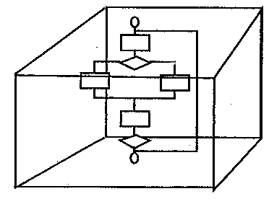
White-Box Testing
Our goal is to ensure that all statements and conditions have been executed at least once.
Code coverage: At a minimum, every line of code should be executed by at least one test case.
51

Slide 52
Flow graph for White box testing
52
To help the programmer systematically test the code
Each branch in the code (such as if and while statements) creates a node in the graph
The testing strategy has to reach a targeted coverage of source code; the objective can be to:
cover all possible paths (often infeasible)
cover all possible nodes/statements (simpler)
cover all possible edges/branches (most efficient)
Notes:
52

Slide 53
Flow chart
Example-1
Flow graph
1
Edge
1
2,3
2,3
2
6
3
7
8
R2
4,5
R3
4
R1
6
Region
9
7
8
5
R4
9
10
10
11
11
53

Slide 54
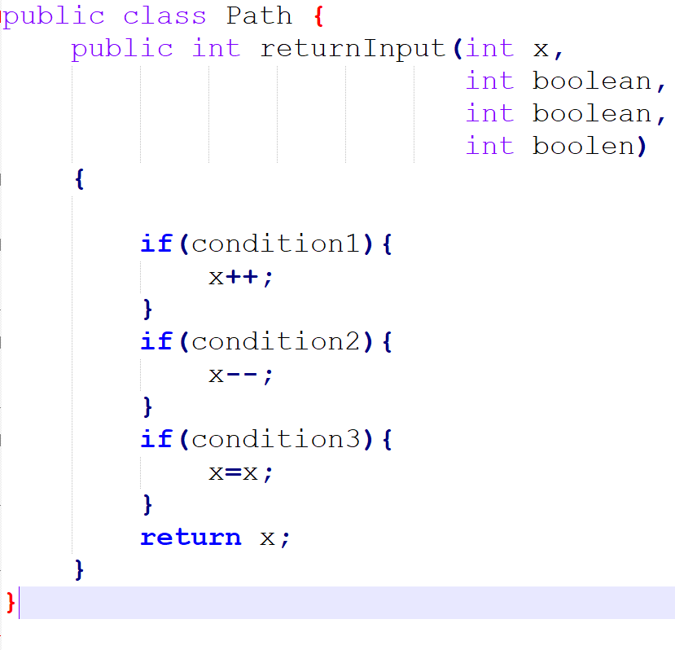
Coverage in White-box testing
Although 100% coverage is an admirable goal, 100% of the wrong type of coverage can lead to problems.
T,T,T would satisfy %100 statement coverage but does not cover all branches

Slide 55
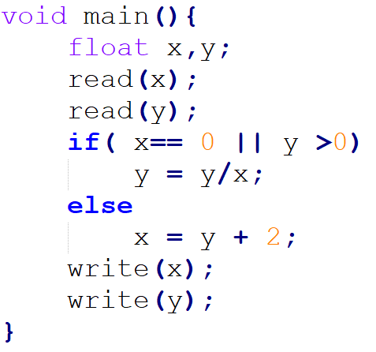
Coverage in White-box testing
Write test inputs for %100 statement coverage
Now for %100 branch coverage
Are these inputs able to catch the defects?

